Slide 1
The introduction of the HVEDR
CATARC
2022.1.31

Slide 2
Background
In the statistics, the proportion of the traffic accidents which the heavy vehicle involved is very high, especially the serious accidents.
The cause of the accident
Human Factors
Vehicle Factors
Speeding
Overloaded
Failure to follow the rules
Drowsy driving
…
Tire
Brake system
lighting and light-signalling devices
…
Accident > 30%
Vehicle < 30%
* The period: 2016-2019

Slide 3
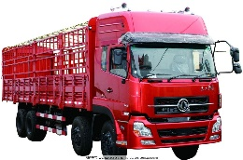
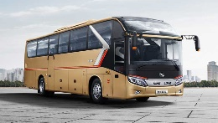
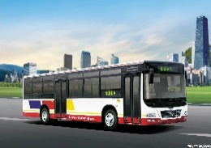
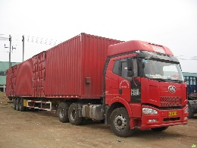
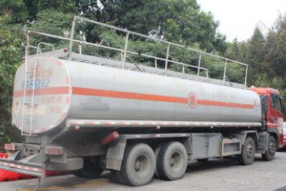
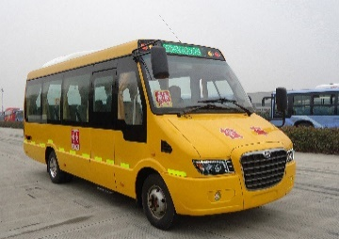
Background
The commercial bus and coach, heavy-duty truck, semi-trailer towing vehicle shall be equipped or used with the vehicle travelling data recorder which meet the national standard.*
GB 7258 — 2017 Technical specifications for safety of power-driven vehicles operating on roads
GB/T 19056 — 2021 Vehicle travelling data recorder
Bus and coach
Vehicles for the carriage of dangerous goods，
School bus
Positioning
Based on satellite positioning system technology, the dynamic supervision and monitoring system of operational vehicles (the National key operational vehicle Network joint control system) has been established.
*Implementing Regulations of law of the People's Republic of China on Road Traffic Safety

Slide 4
Background
*Sample:730,000, Total:3960,000

Slide 5
Vehicle travelling data recorder
Data elements：
Vehicle velocity
Position
Ignition switch
Brake switch
Turn signal switch left
Turn signal switch right
Driving-beam(main-beam)headlamp
Passing-beam(dipped-beam)headlamp
Rear fog lamp
Reversing gear position
Safety belt status
Door(bus or coach: passenger door, truck: driver door)
Performance requirements：
Climate and environment adaptability test: high/ low temperature, damp heat test
Mechanical environment test: vibration, impact
Protection degree: IP43
Resistance to ignition interference
Electrostatic discharge immunity
Transient immunity
Time recording error: 24h, ±2s
Velocity recording error: 0 km/h～220 km/h, ±2 km/h
Positioning: horizontal 15m, vertical 30m
Video quality: resolution 1280×720, 25 fps

Slide 6
Vehicle travelling data recorder
Functional requirements：
DATA
Travelling status: time, position, average velocity per sec (from sensors or CAN), Reference speed (based on satellite positioning signal), Switching signal
Questionable points: 20s before the end of travel; 20s before power-off
Overtime driving: starting time/position, ending time/position
Log Record
Meida
Facing driver and vehicle forward direction, acceleration pedal (electrical bus with length≥6m)
Self-checking
Recording
Data communication
Safety warning
Display
Automatic time adjustment
Positioning

Slide 7
Ideas
The data about vehicle operation and traffic accident can help improve the industry administration and vehicle safety. It is necessary to record those kinds of data.
These vehicles(commercial bus and coach, heavy-duty truck, semi-trailer towing vehicle) are required to be equipped with vehicle travelling data recorder in China. This device is able to record the data which is relevant to the traffic accident.
We need to consider the difference and relationship between vehicle travelling data recorder and HVEDR. We need further research to find potential problems if adopting HVEDR in the future（e.g. the conflict with vehicle travelling data recorder）. We hope the group to consider the practical situation in China.
Of course, we are willing to share the our experience and we would also like to make a deep discussion with group.

Slide 8
Thank you!

